Slide 1

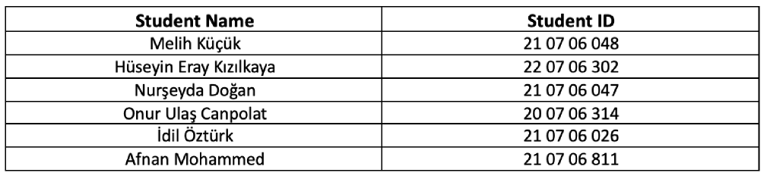
FıkraBot:
A Turkish Joke Generation System with LLM
Advisor: Ensar Gül

Slide 2
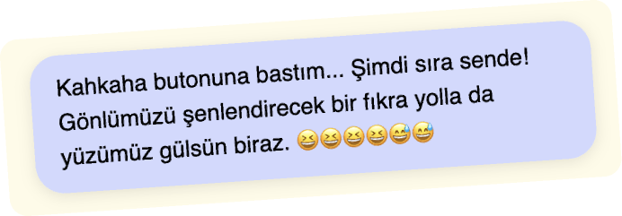
Introduction and Project Overview
Turkish Joke Generator is a natural language generation project designed to create culturally relevant, coherent, and humorous short jokes in Turkish.
The main objective was to build a fast, reliable, and deployable AI-powered system that generates high-quality jokes with a single button click-without requiring any user input or customization.
The project not only focuses on linguistic accuracy and humor relevance, but also emphasizes output safety, content filtering, and consistent formatting, ensuring that every generated joke is both appropriate and contextually natural for Turkish-speaking audiences.

Slide 3
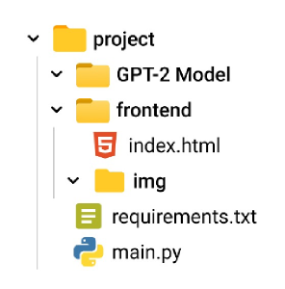

System Features & Functionality
The application features a minimalist, single-button interface that allows users to generate one Turkish joke at a time with zero complexity.
On the backend, the system handles prompt construction, model inference, blacklist filtering, and optional refinement to ensure that each joke is short, contextually appropriate, and free from offensive or irrelevant content.
Since no user input is needed, the system maintains a clean, streamlined user experience and produces consistently structured jokes.
All generation parameters-such as temperature, max tokens, and sampling strategy-are fixed to maintain high output stability and prevent random or incoherent results.

Slide 4
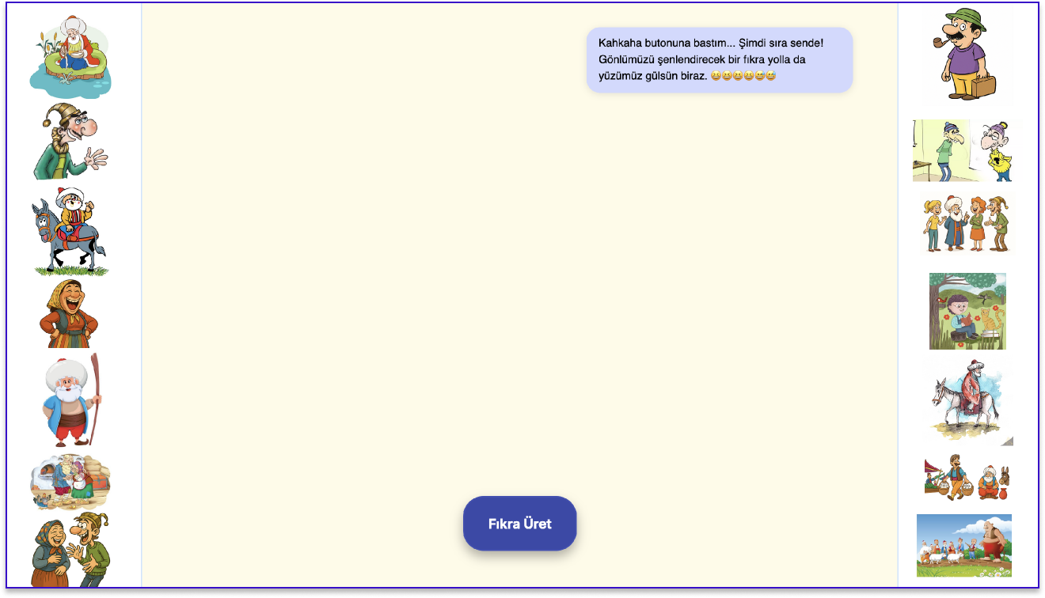

Slide 5
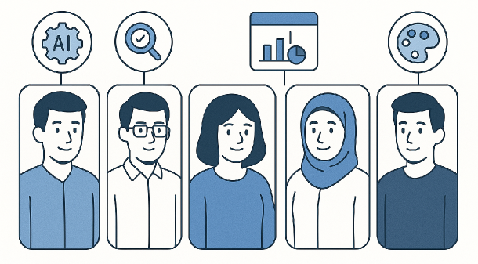
Team Structure and Role Distribution
Our team was composed of six members, each contributing in distinct areas.
Melih served as the team leader, overseeing AI model training and full-stack development.
Hüseyin focused on technology research, data preparation, and contributed to the user interface.
Nurşeyda was responsible for designing and implementing the main frontend.
Onur supported the team with data cleaning and presentation tasks.
İdil assisted in frontend development and conducted social context research.
Afnan contributed to visual design and helped with dataset collection.

Slide 6
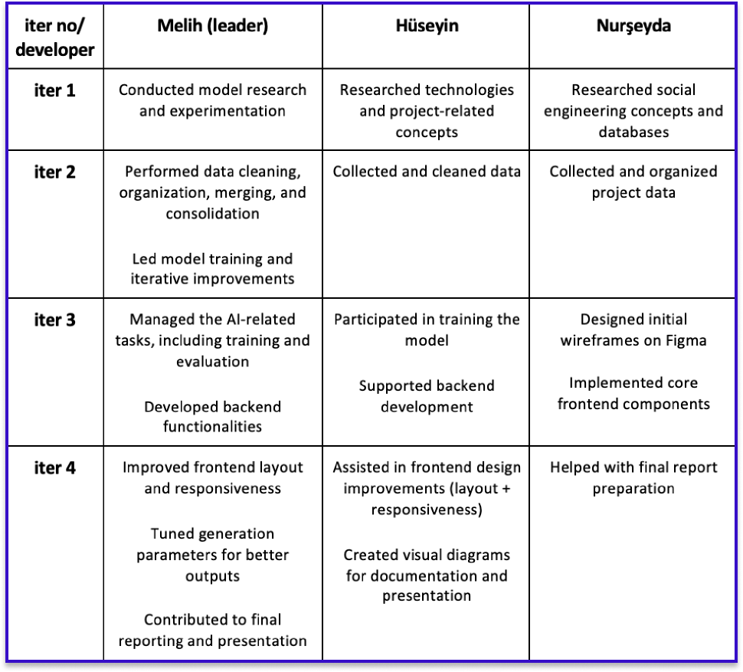

Slide 7
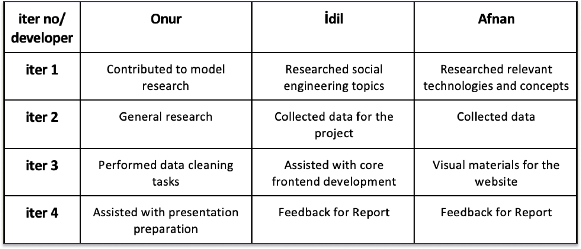
Notes:
999999

Slide 8
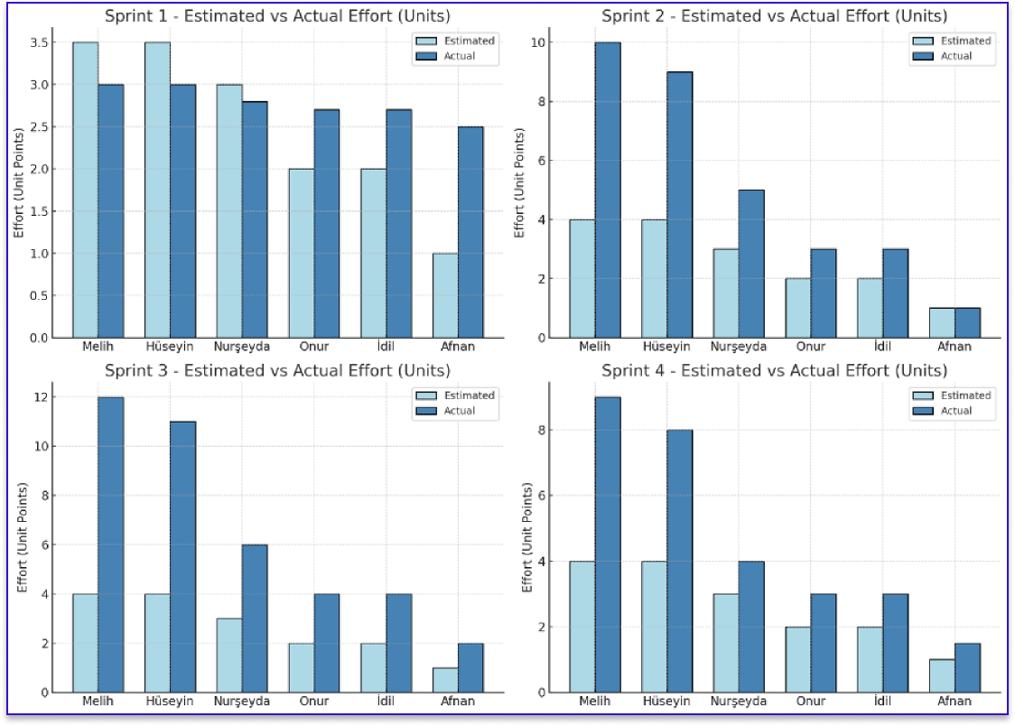
Estimated vs Actual Effort

Slide 9
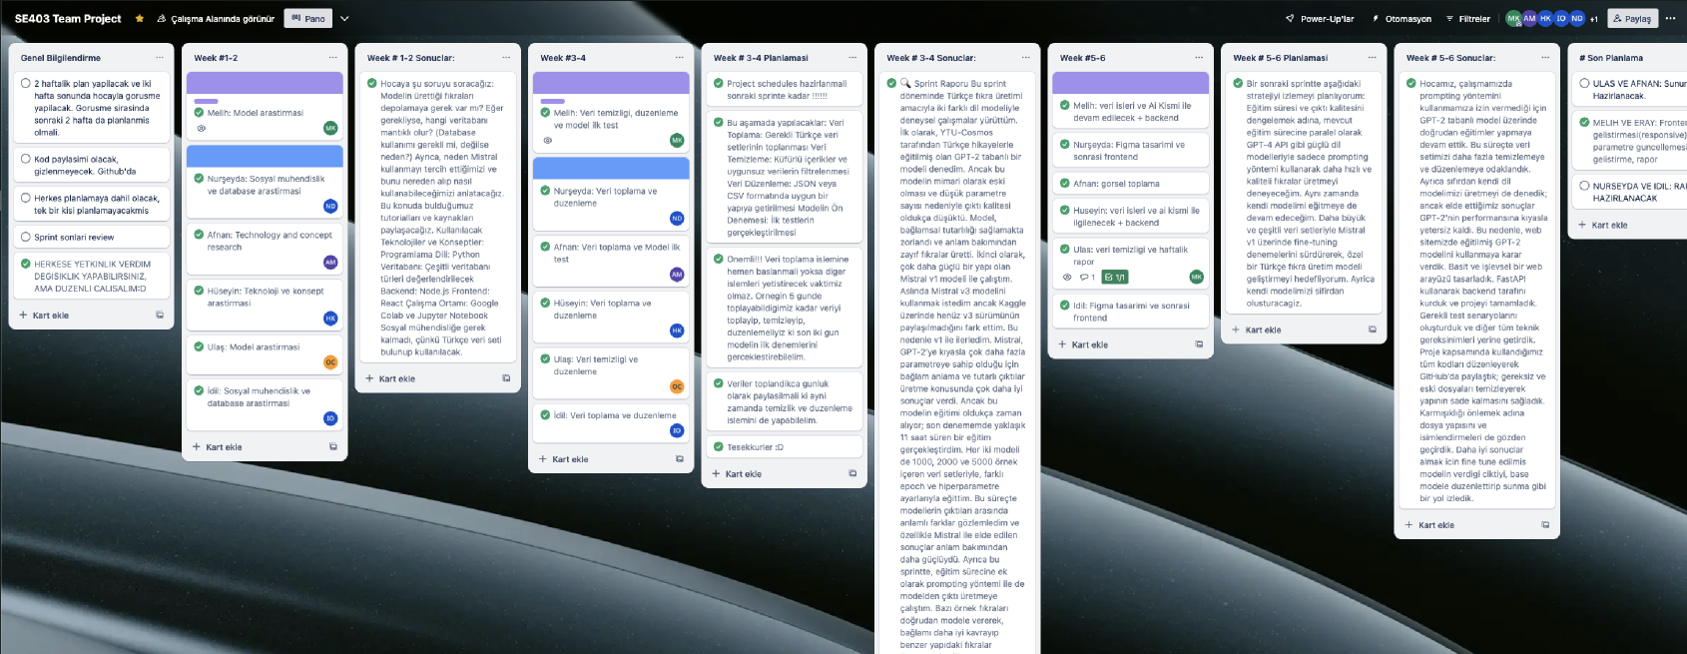
Trello:
https://trello.com/b/xmd1LbLC/se403-team-project

Slide 10






Technologies Used
We used Python as the primary programming language for the backend development. FastAPI was implemented to build the API endpoints for efficient communication between the frontend and the model.
PyTorch and Hugging Face Transformers were utilized for model loading and inference. For fine-tuning, we adopted the PEFT library to apply the LoRA method efficiently.
The frontend was developed using basic web technologies, including HTML, CSS, and JavaScript, with a focus on simplicity and responsiveness.

Slide 11
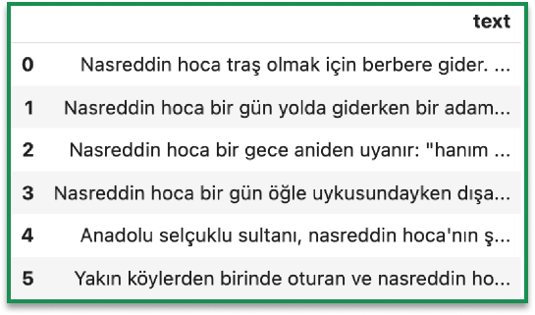


Dataset and Data Cleaning Process
We initially collected approximately 5,000 Turkish jokes from various open-source and semi-structured sources. After a thorough cleaning and preprocessing phase, the dataset was reduced to around 3,600 high-quality and usable samples. During this process, we removed content that included offensive language, explicit references, dates, URLs, or any form of violence.
The final dataset was standardized and formatted consistently in both .csv and .json formats to ensure compatibility with training workflows.

Slide 12


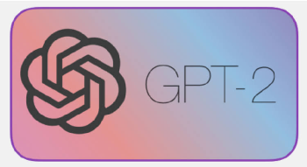
Model Selection and Training
We fine-tuned both the GPT-2 model (YTU Cosmos version) and Mistral v2 using our curated joke dataset.
While GPT-2 was significantly faster in terms of training and inference time, the quality and coherence of its outputs were limited, often lacking contextual fluency. On the other hand, Mistral v2 delivered more context-aware and semantically consistent jokes, but required substantially more computational resources and longer training durations.
Additionally, we conducted experimental trials by training a language model from scratch, primarily to understand the fundamentals of model architecture and data-to-output transformation.

Slide 13
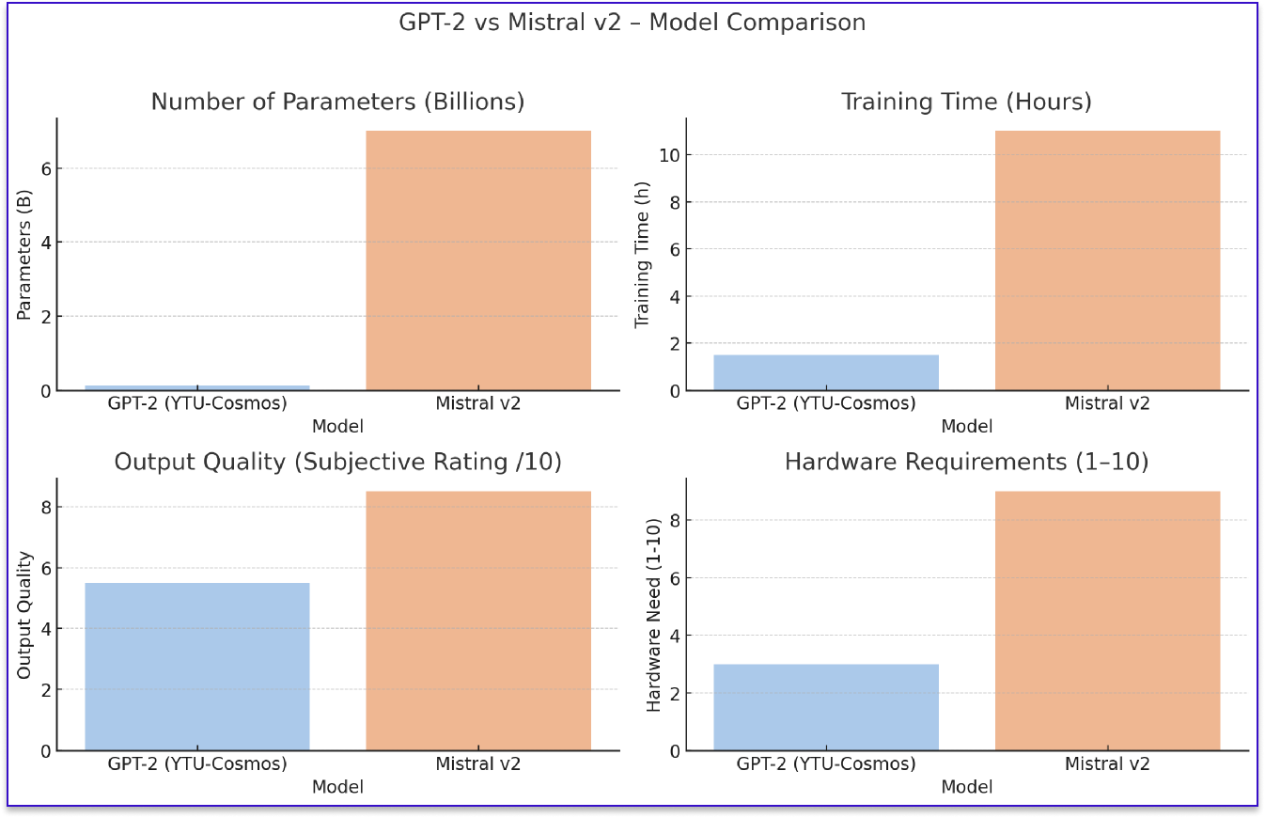

Slide 14
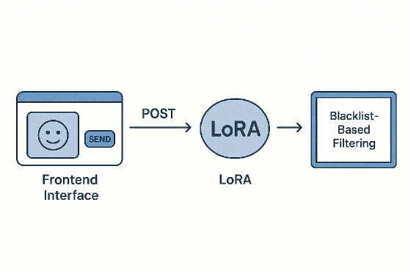

Backend – Frontend Integration Process
The system features a minimalistic frontend interface where a single button click triggers a POST request to the FastAPI backend. Upon receiving the request, the backend applies a predefined prompt and invokes a LoRA fine-tuned language model to generate a joke.
The generated output is then subjected to a blacklist-based filtering mechanism to eliminate inappropriate or irrelevant content. If necessary, the result is further refined using the base version of the model to enhance coherence and fluency. Finally, the polished joke is returned to the frontend and displayed to the user.

Slide 15
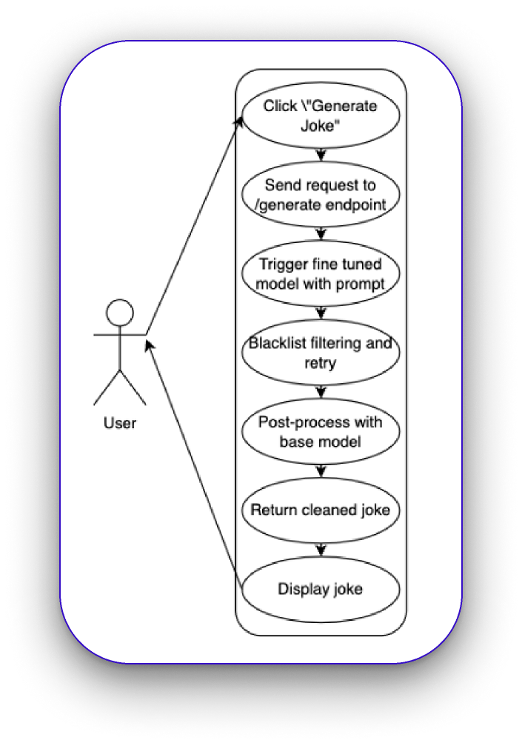

Slide 16
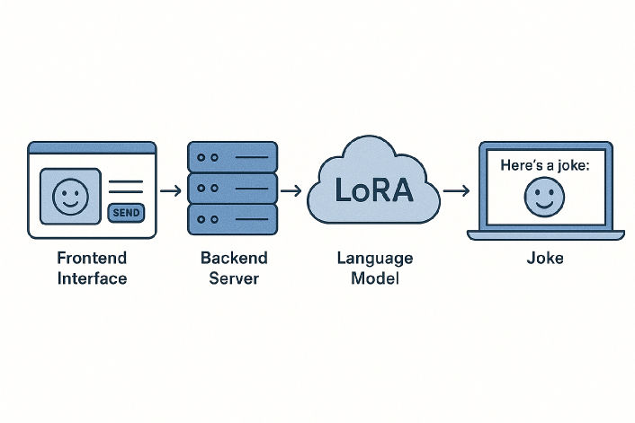
System Flow and Architecture
The system architecture is composed of four main components: a user-friendly frontend interface, a FastAPI-based backend server, a LoRA fine-tuned language model responsible for initial joke generation, and a base model utilized for optional post-editing.
When a generation request is triggered, the backend processes it through these components in sequence-first generating a joke, then filtering it for safety and relevance, optionally enhancing it with the base model, and finally returning the finalized output to the frontend for display.

Slide 17
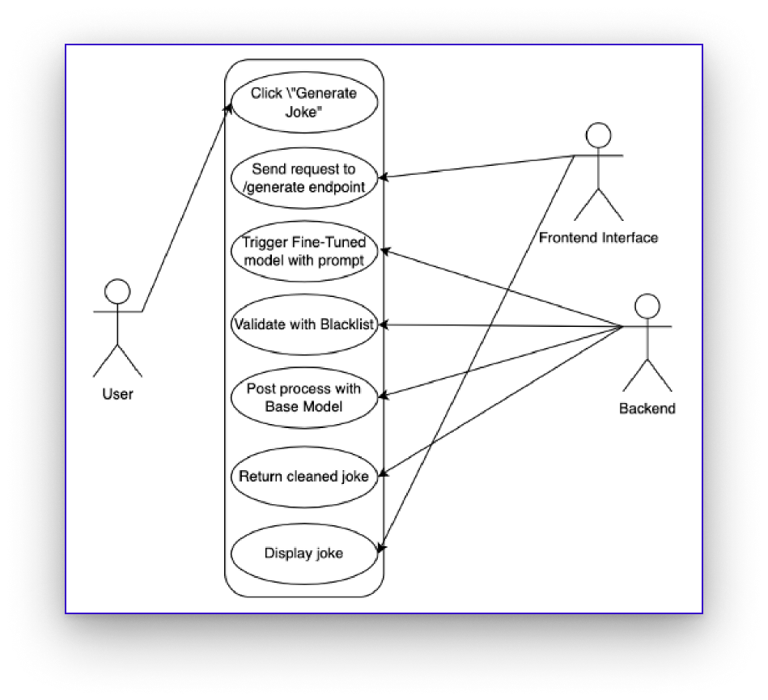
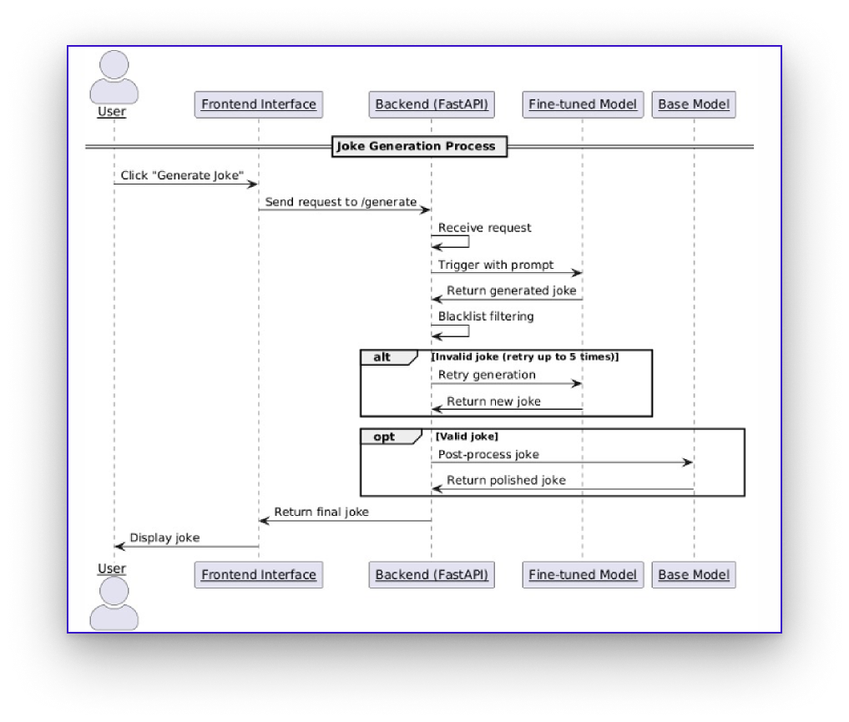

Slide 18

Testing Process
We manually tested each function using Postman and frontend. Tests included blacklist validation, retry logic, joke length, and method restriction. We conducted manual testing of all key functionalities using both Postman and the web frontend.
The tests covered critical aspects such as blacklist pattern validation, retry mechanism behavior for invalid outputs, enforcement of maximum joke length, and restriction of unsupported HTTP methods. Each function was verified to ensure that the system responds correctly under expected and edge-case scenarios.

Slide 19
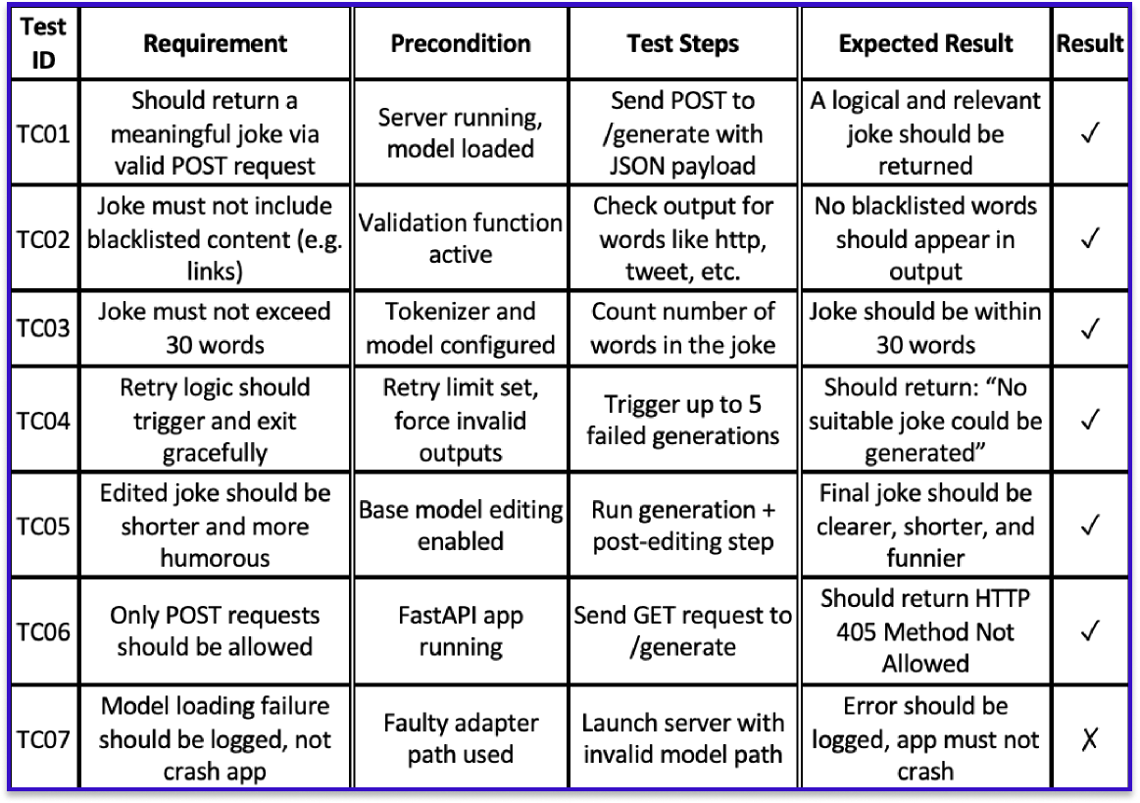

Slide 20

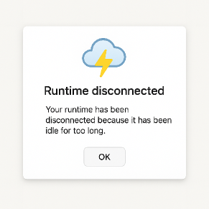
Risks and Challenges️
Throughout the project, we encountered several challenges, including limited computational resources, extended training durations, and difficulties in maintaining consistent data quality.
Selecting the most suitable model architecture was also a non-trivial task, given the trade-offs between performance and hardware constraints.
Additionally, the use of the GPT-4 API was not approved due to institutional limitations, and the availability of large-scale, high-quality Turkish-language datasets was quite restricted, which further complicated the fine-tuning process.

Slide 21
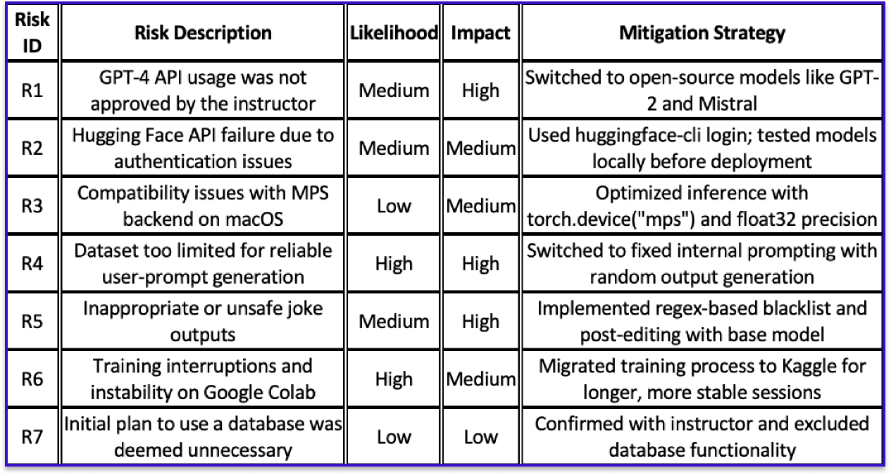
Risks Table

Slide 22
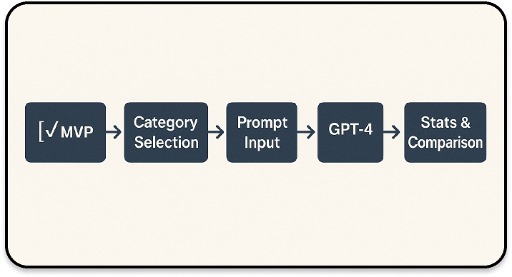
Achievements and Future Plans
Through this project, we gained hands-on experience in full-stack development, language model training, dataset curation and cleaning, and collaborative project management using Agile principles. Each team member had the opportunity to engage with real-world challenges in AI development.
Moving forward, we plan to enhance the system by enabling category-based joke generation, introducing user-defined prompting features, and integrating more advanced models such as GPT-4 for improved output quality and versatility.

Slide 23
🖥️
Live Demonstration

Slide 24


References
Hugging Face. “Transformers Documentation.”https://huggingface.co/docs/transformers
Hugging Face Hub – Model Page. ytu-ce-cosmos/turkish-gpt2-large.https://huggingface.co/ytu-ce-cosmos/turkish-gpt2-large
Google Colab. “Colaboratory Documentation.”https://colab.research.google.com
Kaggle. “Kaggle Notebooks and Dataset Platform.”https://www.kaggle.com
GitHub. “FastAPI Official Repository.”https://github.com/tiangolo/fastapi
PEFT: Parameter-Efficient Fine-Tuning Library.https://github.com/huggingface/peft
PyTorch. “Torch Documentation.”https://pytorch.org/docs/stable/index.html
ChatGPT (OpenAI). Used interactively for debugging assistance, language modeling support, and report drafting suggestions.
Stack Overflow Community. Various posts regarding FastAPI, JSON handling, training issues, and PyTorch deployment.
MDN Web Docs. “Frontend responsiveness and layout strategies.”https://developer.mozilla.org/
https://github.com/Maltepe-University-SWEng/term-project-team-8

Slide 25
Thank you for listening.
Happy to answer your questions.

